Slide 1
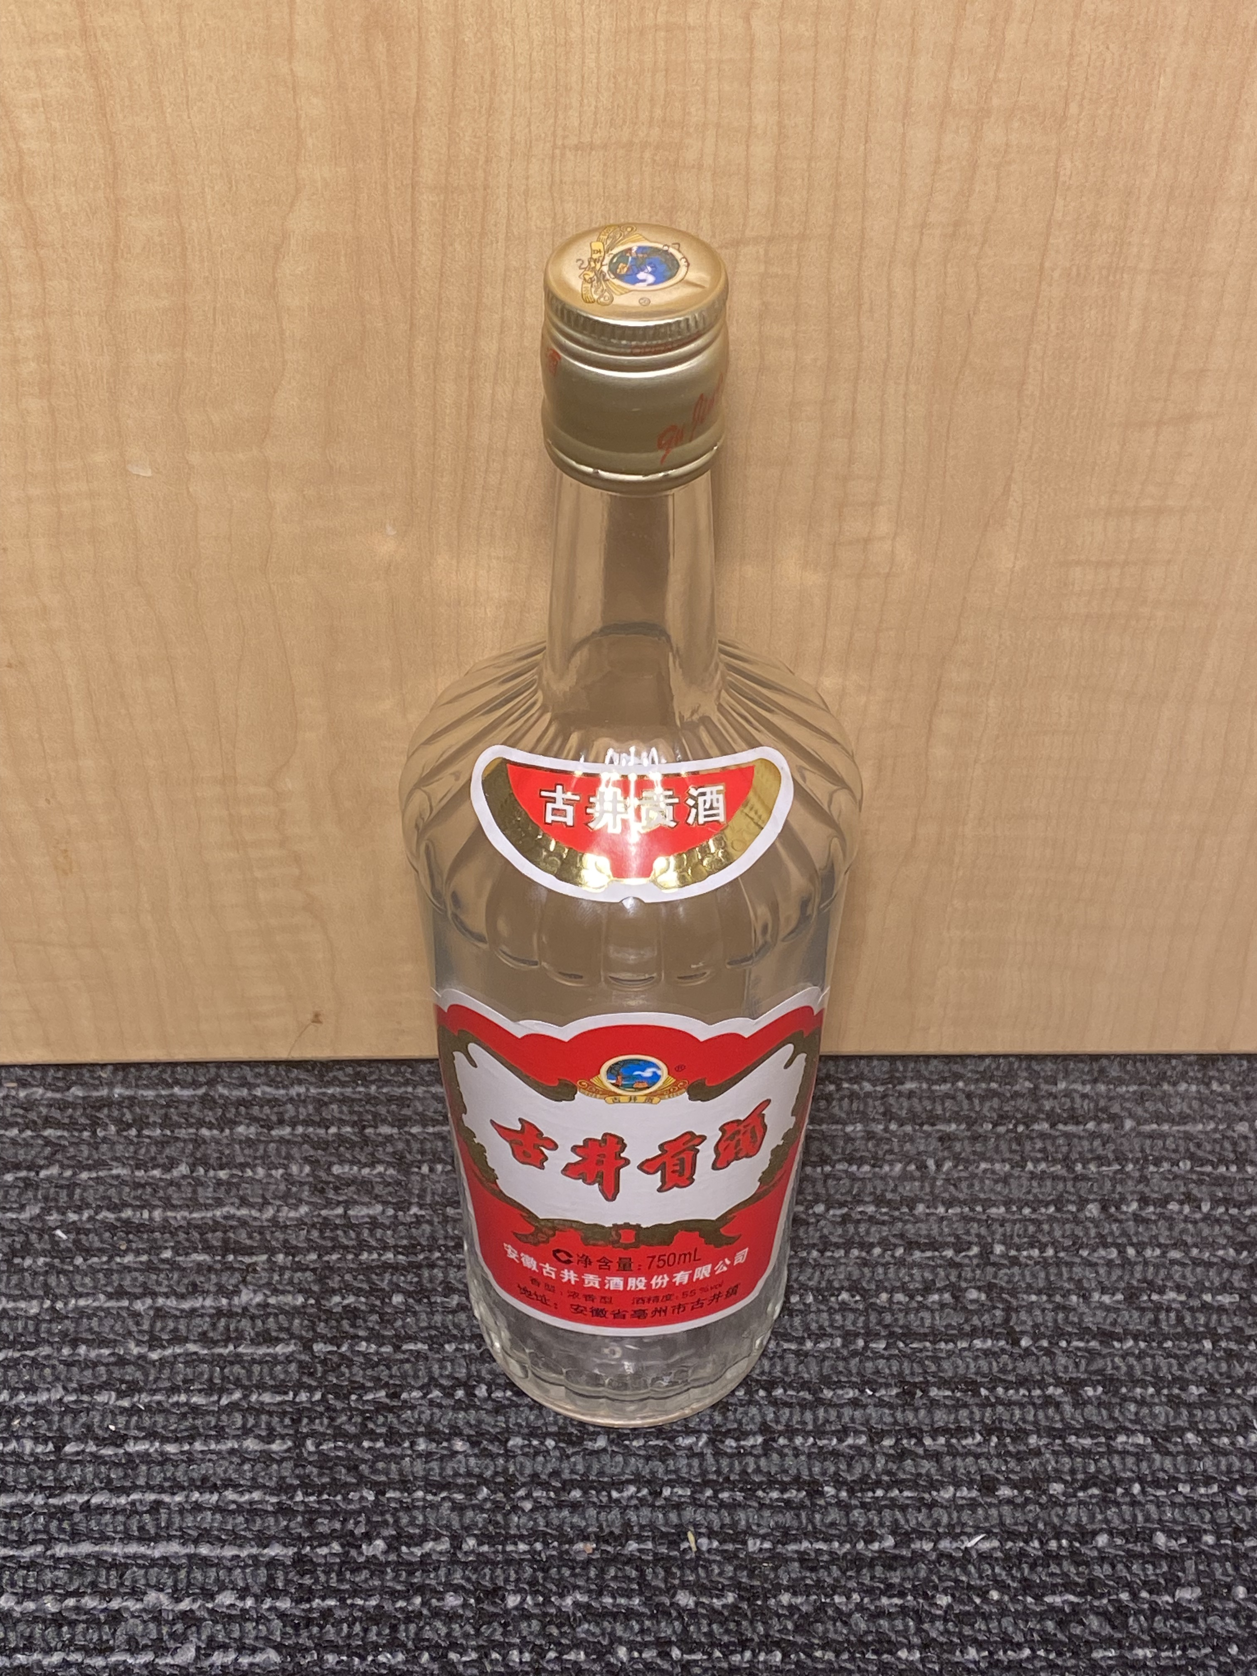
Diameter of Neck
Length of Neck
Volume Below Neck

